Slide 1
Chapter 16: Gravity, Mass, & Inertia

Slide 2
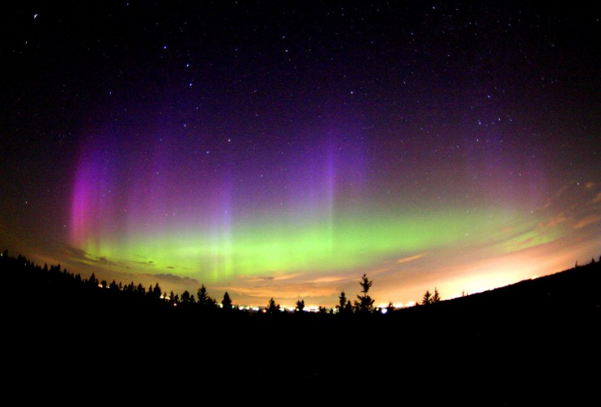
Notes:
“When you look into the nights sky what do you see?” “Where is the sun?”
OBJECT IN OUR SOLAR SYSTEM ARE MOVING

Slide 3
Greek
Ancient Greeks noticed that the patterns of most of the stars didn’t change. The stars seemed to move, but they stayed in the same position relative to one another.
Noticed five points were wandering.
Called them planets, which means “wandering stars”
The names given to these planets were given by the Romans and were named after gods
Notes:
Why did the Greeks only see five planets?
They did not have telescopes and could not see the other planets because they are too dim

Slide 4
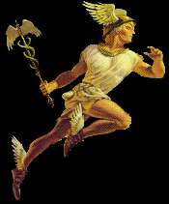
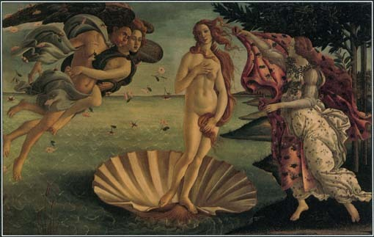
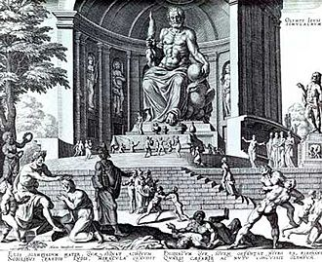
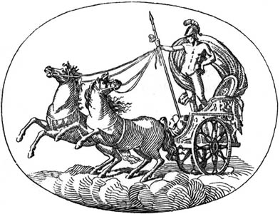
Notes:
5 planets were visible…gods for which they were named
Saturn missing

Slide 5
Geocentric Universe
Greek astronomers believed the universe is perfect and unchangeable and that Earth is stationary in the center of the celestial sphere
A Geocentric System describes a system in which all of the planets revolve around Earth
Remember: A system is a group of parts that work together as a unit.
(Earth = Geo) + (Centric = Centered) = Geocentric

Slide 6
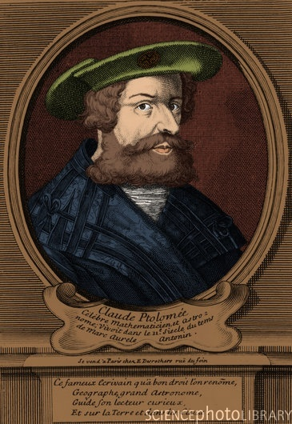
Geocentric Universe: Ptolemy
Ptolemy also believed in a geocentric system
thought the planets moved on little circles that moved on bigger circles
Believed this for 1400 years
Notes:
Caption: A portrait of Claudius Ptolemy. (Enhancement of BD5195)

Slide 7
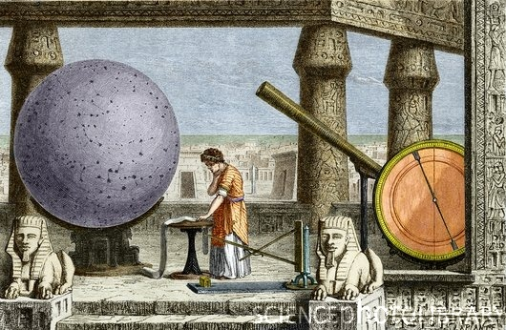
Notes:
Caption: Ptolemy's observatory in Alexandria, ancient Egypt. Coloured historical artwork of Claudius Ptolemy (AD c100-170), an Egyptian or Greek astronomer, geographer and mathematician, surrounded by astronomical equipment. Among the instruments seen are Ptolemy's rulers (lower centre) and a copper disc (far right), which he used to demonstrate the law of reflection. At this observatory Ptolemy made the observations that supported Earth-centred models of solar and planetary motion. This view dominated astronomical thinking until the mid 16th century. Engraving from the 19th century book Vies des Savants Illustres.

Slide 8
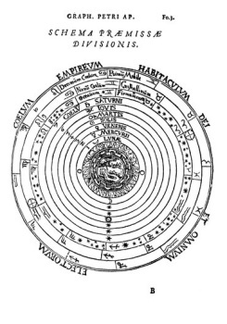
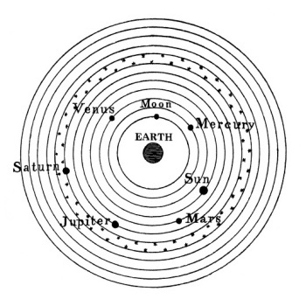
Notes:
Caption: Aristotelian cosmology, with astrological and zodiacal symbols. This Earth-centred (geocentric) worldview originated with the Ancient Greeks and dominated medieval Europe until the time of Copernicus (1543). The heavenly bodies circled the Earth attached to spheres. At centre are the four elements of Earth, Water, Air and Fire. Then there are successive spheres for the Moon, Mercury, Venus, the Sun, Mars, Jupiter and Saturn. The outer three spheres are: the Firmament (including the stars), the Crystalline Heaven, and the Primum Mobile. Beyond this is the Empyreal Heaven, the Abode of the Blessed. Published in Cosmographia (1524) by the German astronomer PetrusApianus.
Caption: Ptolemaic cosmology. Historical artwork of the Earth-centred (geocentric) Ptolemaic cosmological model. This system is known through the Almagest of the Egyptian-Greek astronomer Ptolemy who lived in the 2nd century. This work summarized 500 years of Greek astronomy and this model of the heavens owes much to work by Hipparchus. The Moon, the Sun and the five known planets inhabited a series of perfect, Earth-centred, rotating spheres, ending in a sphere of stars. Later astronomers added more spheres to improve the model. However, inaccurate predictions led to it being overthrown by the 1543 Sun-centred (heliocentric) model of Copernicus. From Bilder Atlas by Johann Georg Heck, 1860.

Slide 9
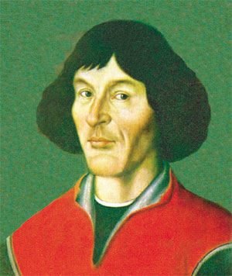
Heliocentric Universe: Copernicus
Early 1500’s
Polish astronomer Nikolas Copernicus developed another thought about the motion of the planets
Believed the Earth and the planets revolved around the sun.
This is called a “Heliocentric System”
(Helios = sun) + (Centric = Centered) = Heliocentric
Notes:
“Here comes the sun”

Slide 10
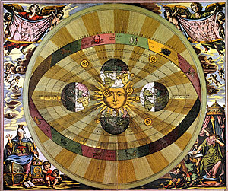
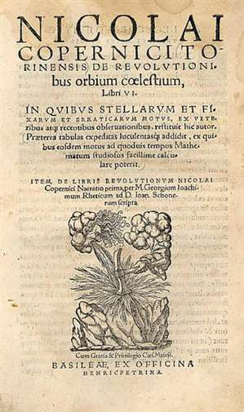

Slide 11
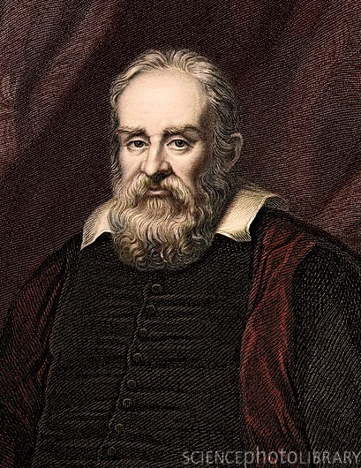
Heliocentric Universe: Galileo
Galileo Galilei, lived nearly 100 years after Copernicus agreed with Copernicus
First scientist to use a telescope to look at objects in the sky
Two discoveries that supported the heliocentric model: 1) saw four moons revolving around Jupiter – not everything in the sky revolves around earth 2) observed Venus goes through phases similar to those of Earth’s moon.
Notes:
Caption: Galileo Galilei, Italian astronomer. Engraving by Robert Hart 1834 from 'The Gallery of Portraits' from the painting by Ramsay ref Susterman's 1636 with later tinting. In 1610 Galileo observed mountains on the moon, four satellites of Jupiter and numerous dim stars. In his book, Dialogue of the Two Chief World Systems he discussed Ptolomeic and Copernican (heliocentric) cosmologies. He thought his discussion was tactful, but it was considered heretical by the Inquisition in 1633 and he was sentenced to house arrest for life. He also studied the dynamics of falling bodies, and Boyle would later confirm in his experiments that bodies fell at the same speed in a vacuum. Galileo improved the operation of telescopes, and pioneered the microscope after hearing of the first compound microscopes being made in the Netherlands. Albert Einstein called him the father of modern science.

Slide 12
Galileo’s Moons of Jupiter

Slide 13
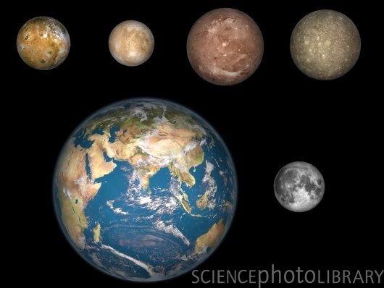
Notes:
Caption: Jupiter's moons and the Earth. Computer artwork of Jupiter's four largest satellites laid out above the Earth and it's moon, showing their comparative sizes. From left to right, in order of their distances from Jupiter: Io, Europa, Ganymede, Callisto. These moons, also known as the Galilean satellites, were first observed by the Italian astronomer Galileo over 400 years ago, and are worlds in their own right.

Slide 14
Night 1
Notes:
Students mark data sheet.
Track only Io and Calisto
See smartboard animation

Slide 15
Night 2

Slide 16
Night 3

Slide 17
Night 4

Slide 18
Night 5

Slide 19
Night 6

Slide 20
Night 7

Slide 21
Night 8

Slide 22
Night 9

Slide 23
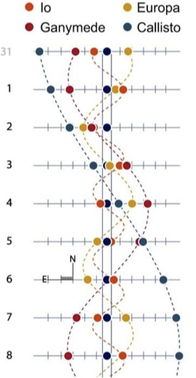

Slide 24
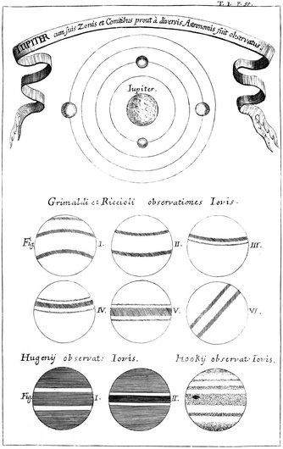
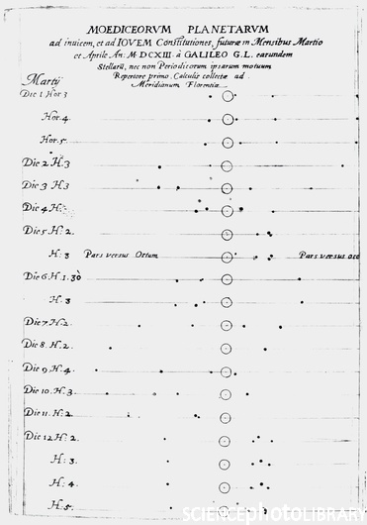
Notes:
Caption: Observations of Jupiter, published in Specula Physico-Mathematico-Historica (1696), a book published by the German monk and author Johann Zahn (1641-1707). The labels are in Latin. The top diagram shows Jupiter and the four main (Galilean) moons. The bottom nine drawings are observations of the bands of clouds on Jupiter, made by the astronomers Francesco Maria Grimaldi (1618-1663), Giovanni Battista Riccioli (1598-1671), Christiaan Huygens (1629-1695) and Robert Hooke (1635-1702). Early observations of Jupiter with telescopes began with Galileo's discovery of its moons in 1610, followed by observations of its clouds in the following years.
Caption: Galileo's paper on Jupiter's moons. Sketches of the changing position of the moons of Jupiter over the course of 12 days, as recorded by the Italian physicist, mathematician and astronomer Galileo Galilei (1564-1642). The text is in Latin. Jupiter is the large circle, while the four moons are the dots either side. Galileo's discovery of these moons was made in 1610, using telescopes he had built himself. This was the first time it had been shown that heavenly objects existed that did not orbit the Earth. This challenged existing views that held the Earth to be at the centre of the universe. The moons are named the Galilean satellites in Galileo's honour. These sketches were published in IstoriaeDimonstrazione (1613).

Slide 25
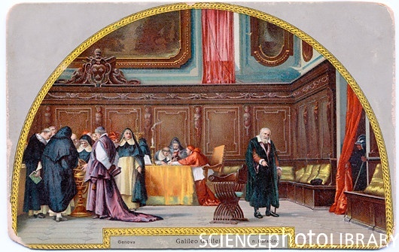
Galileo’s Trial
Notes:
Caption: Galileo's trial. Artwork of Italian astronomer Galileo Galilei's 1633 trial for heresy by the Roman Catholic Church. Galileo (1564-1642, right) wrote the Dialogue Concerning the two Chief World Systems (1632), criticising the Church's doctrine that the Earth was at the centre of the Universe (Ptolemaic cosmology). Galileo said the Copernican (Sun-centred) system was correct. Church officials are examining astronomical models at left. Galileo was threatened with death and he finally renounced his views on 22 June 1633. He was kept under house arrest for the rest of his life. His conviction was revoked in 1992. Early 20th century Italian postcard of a 19th century fresco by N. Barabino.

Slide 26
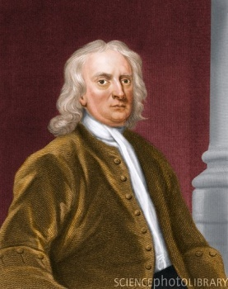
Sir Isaac Newton: Gravity & Inertia
Why do the planets stay in orbit?
Built on Galileo’s work on Inertia (A moving object will continue in a straight line or a stationary object will remain in place.)
Concluded the planets stay in orbit because of both Gravity and Inertia
GRAVITY + INERTIA = ORBIT

Slide 27
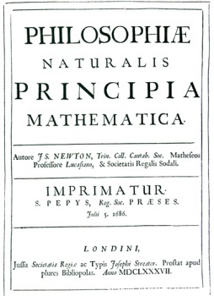
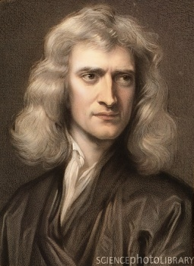
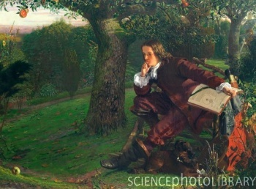
Notes:
Caption: Sir Isaac Newton (1643-1727), British physicist, mathematician and astronomer. Newton's most famous works are Principia Mathematica (1687) and Opticks (1704). In Principia, he stated his universal laws of motion and defined his law of universal gravitation. This would form the basis of physics for the next 200 years. In Opticks, Newton discussed the spectrum of light, showing that it was a mixture of colours. He also invented the reflecting telescope. He was President of the Royal Society from 1703 to 1727, and was knighted in 1705.
Caption: Frontispiece of the first edition of Isaac Newton's great work, PhilosophiaeNaturalis Principia Mathematica ("Mathematical Principles of Natural Philosophy"), published in three volumes in April 1687. Written in Latin, the book set out the laws of motion & Newton's theory of universal gravitation. Only about 300-400 copies of the first edition were printed. It was not published in English until 1729. Newton (1642- 1727) is described on the frontispiece as a Fellow of Trinity College and Lucasian professor of mathematics at the University of Cambridge, and a Fellow of the Royal Society (of which he became President in 1703).
Caption: Sir Isaac Newton ( 1643-1724), English physicist. Newton was born at Woolsthorpe Manor in Lincolnshire and was educated at Grantham and at Trinity College Cambridge. In 1665 he discovered the binomial theorem of mathematics. In the same year he returned to Woolsthorpe while the University was closed due to fears of the plague. In the next two years Newton created his three laws of motion, his theories of gravitation and optics and his mathematics of the calculus. In 1687 he published PhilosophiaeNaturalis Principia Mathematica in which most of classical mechanics is outlined. In 1704 he published his book Opticks, in which he described the dispersion of white light by a prism and his reflecting telescope among other things. This painting by Robert Hannah shows Newton in the orchard at Woolsthorpe, where legend has it he was inspired by a falling apple to explain gravitation.

Slide 28
A Geocentric System describes a solar system in which all of the planets revolve around the Earth.
A heliocentric system describes a solar system in which all of the planets revolve around the sun.

Slide 29
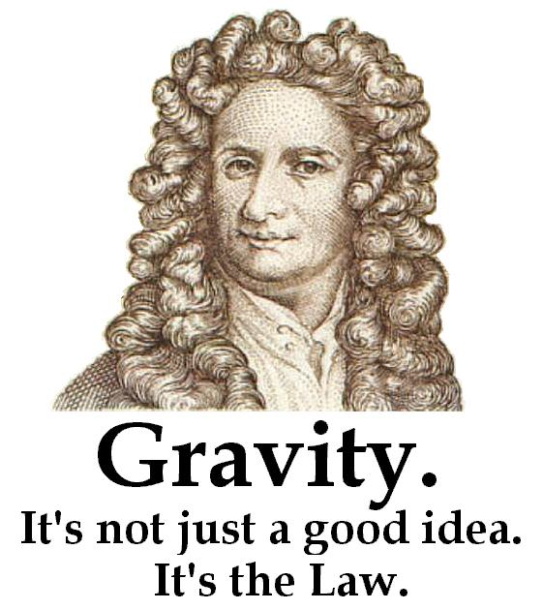
Gravity
Gravity attracts (or pulls) all objects toward one another.
The strength of gravity depends on the mass and distance between the objects
Notes:
Why don’t you feel yourself pulling on the earth?

Slide 30
Gravity
Massive objects exert a stronger pull than less massive objects
Notes:
You pull toward center of earth since all have gravitational field you pull earth toward you too but you cant really feel it earth toward you, but since

Slide 31
Gravity
Objects that are far apart exert less force than objects that are closer together
Notes:
You pull toward center of earth since all have gravitational field you pull earth toward you too but you cant really feel it earth toward you, but since

Slide 32
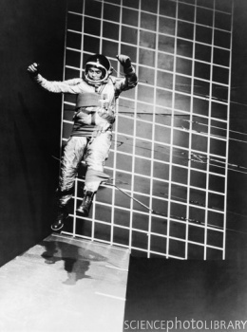
Mass
Objects MASS is not WEIGHT.
Mass is stuff in an object – the measure of how much matter is in an object
Weight is force exerted on an object by gravity
Hammer and Feather Drop on Moon
Notes:
Why can this astronaut jump so far?
Caption: A system of slings supports most of a researcher's weight, allowing him to walk and jump under conditions simulating lunar gravity. Part of a series of studies conducted by NASA's Langley Research Center to study the ability of astronauts to perform tasks while encumbered in spacesuits.

Slide 33
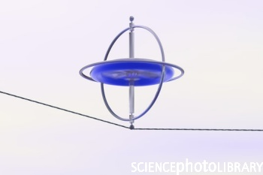
Inertia
A moving object will continue in a straight line or a stationary object will remain in place due to inertia.

Slide 34
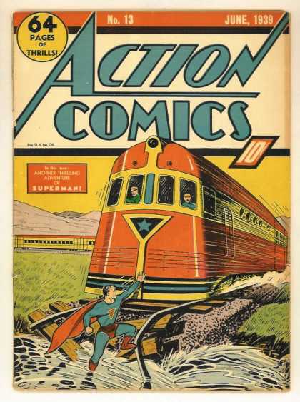
Mass, Inertia, & Motion
The more mass an object has, the more inertia it has
The more inertia an object has, the harder it is to start or stop or change directions.
Notes:
Toy truck
Weights on string
Why does the moon fly off into orbit?
Moon is actually slowly moving out of orbit

Slide 35
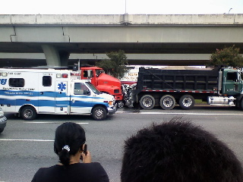
To the left you see a picture of a Smart Car.
Below is a Photo of an accident near New Orleans Involving Two Trucks and a Smart Car at less than 10 MPH.

Slide 36
Gravity + Inertia = Orbit
The moon keeps moving ahead because of inertia – It wants to keep on moving!
Earth curves away as the moon falls toward it, so the moon winds up in orbit around Earth
Earth wants to move from the sun just like the moon wants to move from Earth!
This is the same for everything in the solar system

