Slide 1
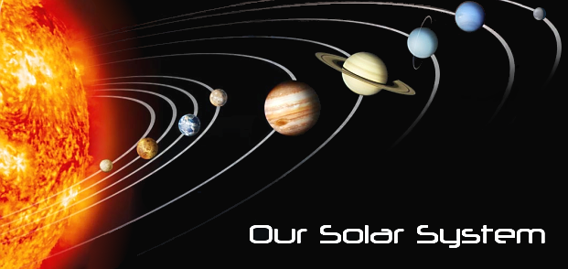
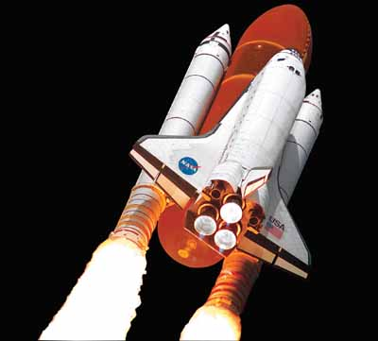
A Trip through
Grab Your Solar System Passport and Let’s go !!

Slide 2
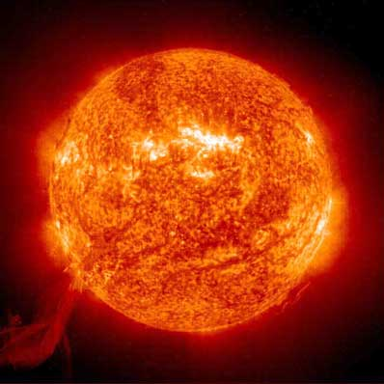
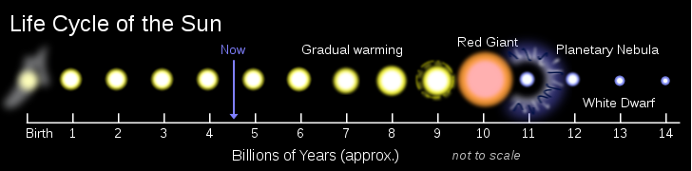
The Sun
Star at the center of the solar system
Contains 99.86% of the Solar System’s Total mass
Mostly Hydrogen and Helium
Energy produced by Nuclear Fusion

Slide 3
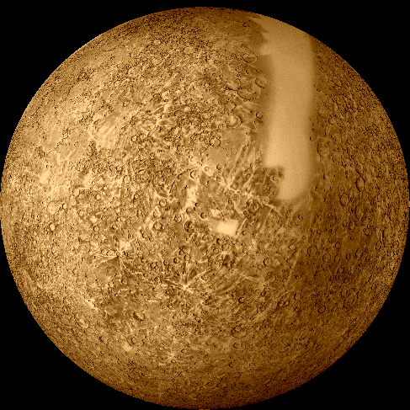
Mercury
Closest Planet to the Sun
Can only be seen from Earth during Sunrise/Sunset due to its proximity to the sun
Of all the planets, Mercury has the greatest Temperature Range between night and day!
  Max 430 ⁰C (degrees Celsius)
  Min -170 ⁰C (degrees Celsius)

Slide 4
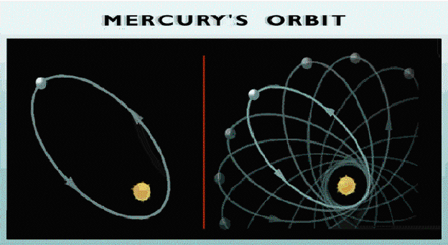
Motions of Mercury
It takes Mercury 2 revolutions to completes 3 rotations on its axis ( On other words, it takes 2 years to make 3 days)
The orbit of Mercury is an elongated ellipse, but it does not go back to exactly where it was before, it returns slightly ahead where it began
Length of rotation on axis- 59 days
Length of revolution around sun- 88 days

Slide 5
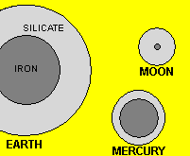
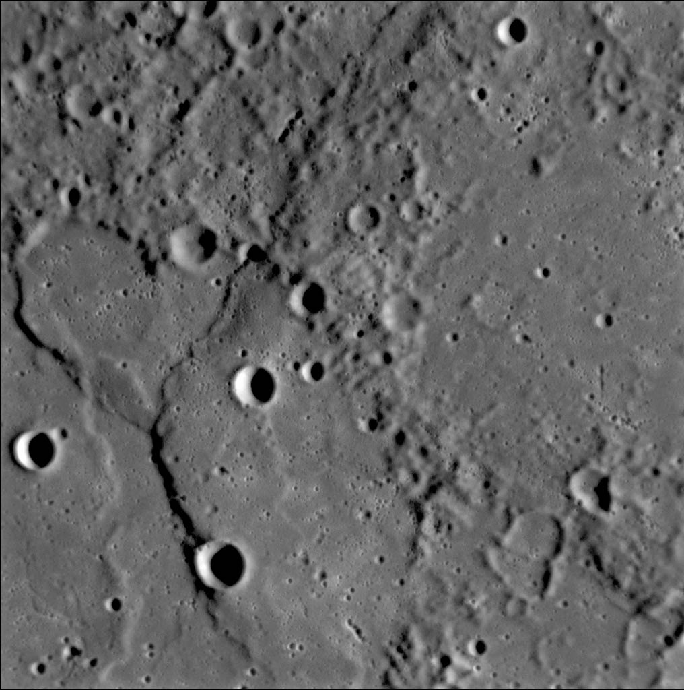
Composition of Mercury
Extremely Dense (5.4 x water)
Composed of mostly metals
  Iron and Nickel core
  Rock layer
  Brittle cracked crust
Highly Cratered Surface due to bombardment from space
Rocky surface of solidified lava and high cliffs
Scientists suspect frozen water (H20) may be trapped deep in some of the craters at the poles which never get sunlight

Slide 6
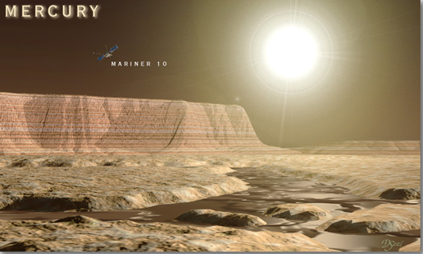
Atmosphere of Mercury
Extremely thin atmosphere(almost none)- very small amounts of Sodium and other gases
Most gases escaped early on because they became highly excited by heat from the sun and were not contained due to Mercury’s weak gravitational pull
On Mercury a100 lb object = 38 lbs

Slide 7
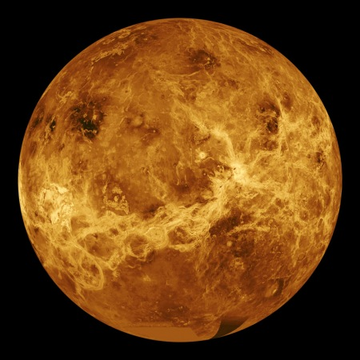
Venus
Temperature Range
  Max 460 ⁰C- surface
  Min -46 ⁰C- cooler outer atmosphere
Extremely bright object in sky
Often called the Evening Star or Morning Star because it can only be seen at sunset/sunrise
Why is this true?

Slide 8
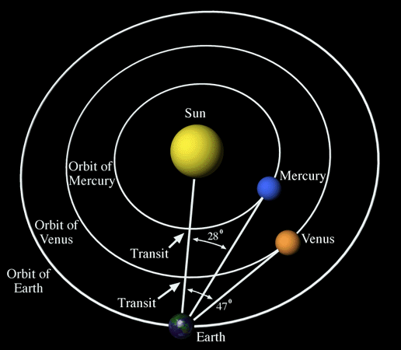
Why can we only see Mercury and Venus during sunset and sunrise?
In order to view Mercury and Venus from Earth, we must look inward toward the sun (as opposed as outward into the darkness of space)
The only time we can see that direction is during the day
During mid-day, the sun is too bright and “whites-out” our view of these planets, making sunrise/set the only time they are viewable!

Slide 9
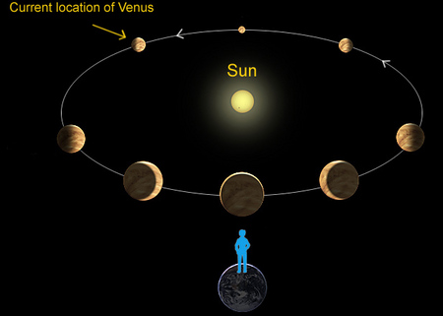
Motions of Venus
It’s day is longer than it’s year!
Rotates East to West, known as Retrograde Motion, the opposite of most other planets
In other words, if you were on Venus, the sun would rise in the West and set in the East
From our perspective, Venus exhibits phase changes, much like our moon
Length of rotation on axis- 243 days
Length of revolution around sun- 225 days

Slide 10
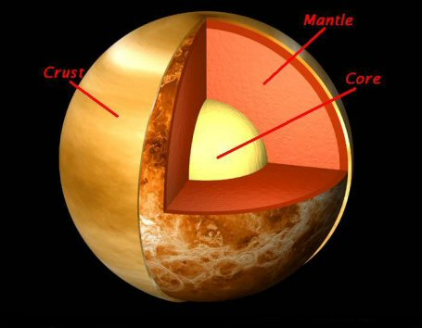
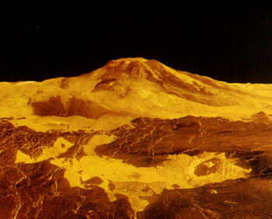
Composition of Venus
Very dense (5.2 x water)
Composition similar to Earth with a metal core, liquid rock mantle and and solid outer rock crust
Rocky, dusty, and waterless
Mountains, Canyons, Plains and huge hardened lava flows

Slide 11
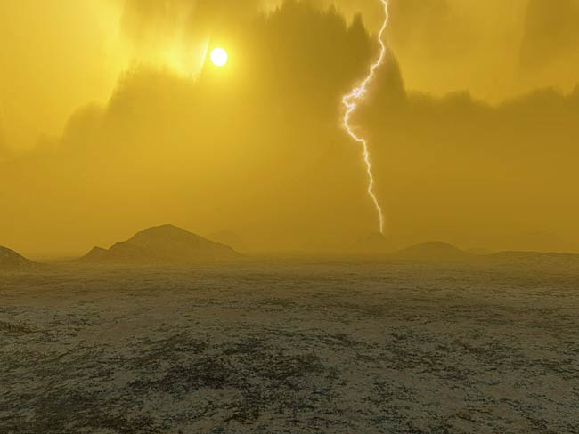
Atmosphere of Venus
Hostile Conditions
Constant cloud cover, no sunny days!
Atmospheric pressure is 90 times greater than Earth, enough to crush you
Atmosphere composed of Carbon Dioxide (CO2) and Sulfuric acid, not breathable
Green House Effect makes the surface very hot!

Slide 12
Green House Effect on Venus
Venus is closer to the sun than the Earth
Therefore it receives more solar energy
Surface of Venus becomes very hot
Heat is reflected off the surface, but not allowed travel into space due to cloud cover
Carbon dioxide (CO2) cloud cover traps the energy of the sun
Surface reaches 460 degrees Celsius!!

Slide 13
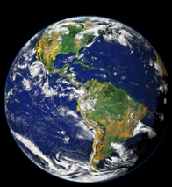
Earth
Temperature Range
  Max 60 degrees C
  Min -90 degrees C
In the “Goldilocks Zone”
Only planet with liquid water
The only planet in our solar system with suitable conditions for development of life
The most dense planet! (5.5 x water)

Slide 14
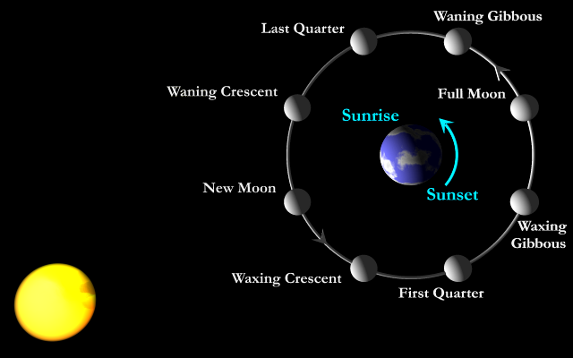
Motions of Earth
Length of rotation-
  24 hours = 1 day
Length of revolution-
  365.2564 days = 1 year
One satellite: The moon

Slide 15
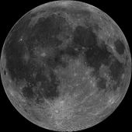
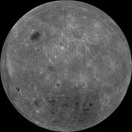
About the Moon
Fifth largest moon in the solar system
Almost no atmosphere
A quarter of Earth’s size
Only celestial body on which humans have made a manned landing
Currently believed that the moon was created when a Mars sized body collided with the Earth and the debris recollected and accreted
Light (front) side of the Moon
Dark Side of the Moon
(the view we never see)
Scale Model of Earth Moon System
http://upload.wikimedia.org/wikipedia/commons/6/60/Speed_of_light_from_Earth_to_Moon.gif

Slide 16
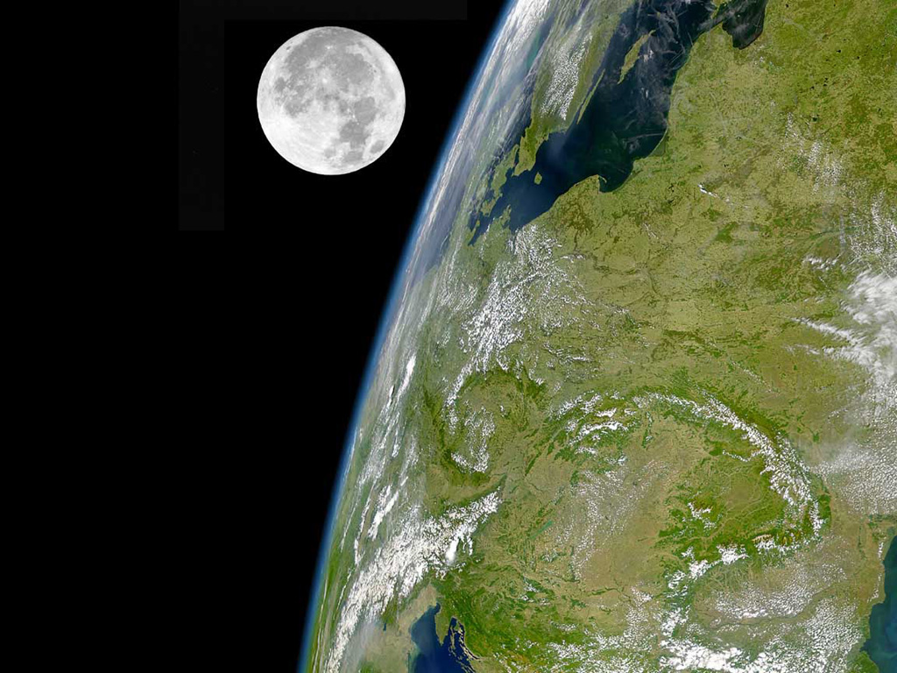
Earth’s Moon

Slide 17
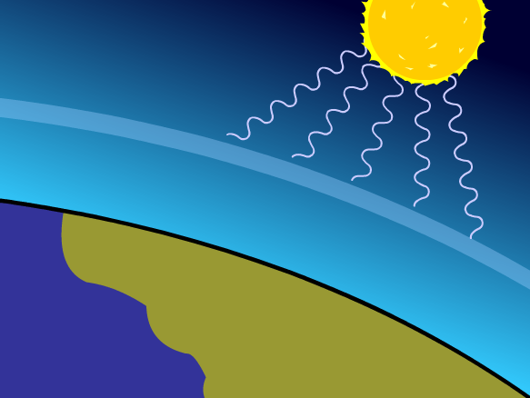
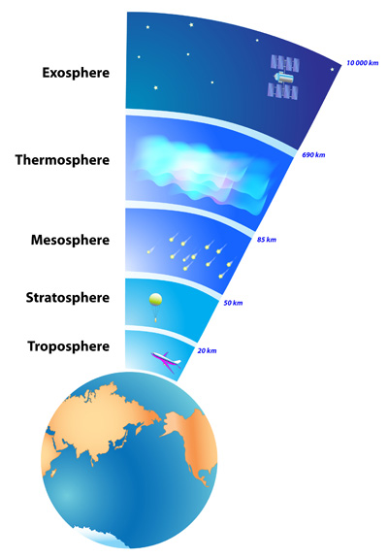
Earth’s Atmosphere
thin layer with mixture of gases and water vapor
Green house effect keeps surface warm enough for life to exist.

Slide 18
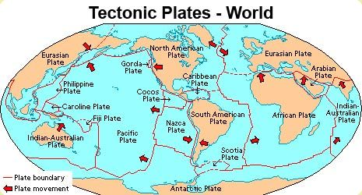
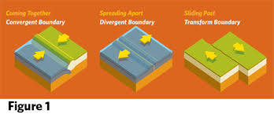
Earth’s Crust
Broken into tectonic plates that move past, toward and away from each other
Constantly created and destroyed

Slide 19
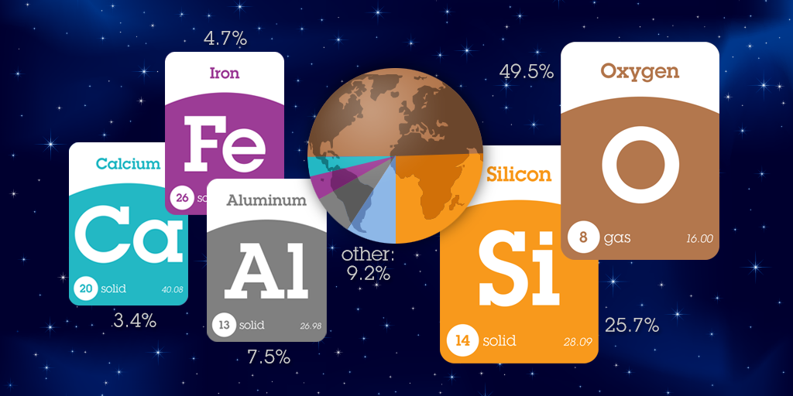
Crust Composition
Mostly Oxygen and Silicon

Slide 20
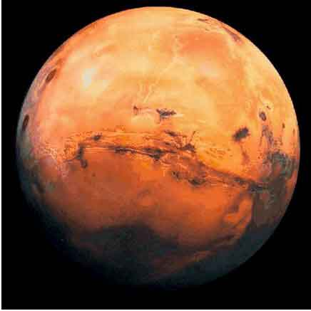
Mars
Known as the Red Planet
Rocky surface covered in an Iron oxide dust
Prone to dusty wind storms (62 mph winds)
Most like Earth showing seasons and polar ice caps
Temperature Range
  Max 20 ⁰C
  Min -125 ⁰C

Slide 21
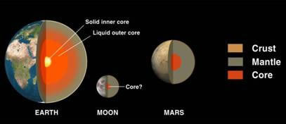
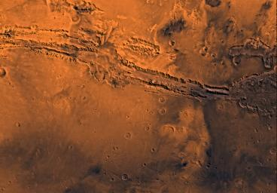
Composition of Mars
Surface composed of Basalt covered in Iron Oxide Dust
Likely Iron and Sulfur core
No Magnetic Field now, but magnetic bands in rocks are evidence that it once had a rotating metallic core and plate tectonics
Once had active Volcanoes

Slide 22
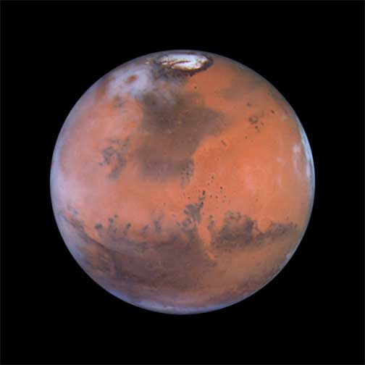
Martian Geography
Only planet in which geographic features can be seen from Earth (with a telescope)
Evidence that water once flowed
CO₂ icecaps at both poles
Frozen water discovered in the North pole

Slide 23
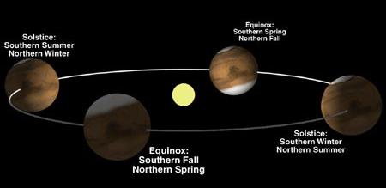
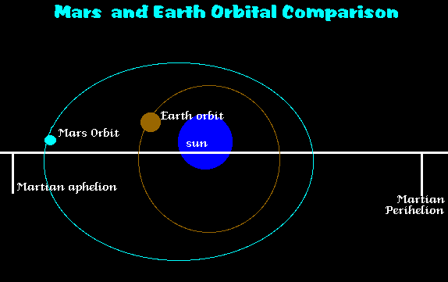
Motions of Mars
Rotation length- 24.5 hours
Revolution length- 687 days
Mars experiences seasons much like Earth because it is tilted on its axis
They are much longer due to its more elliptical orbit

Slide 24
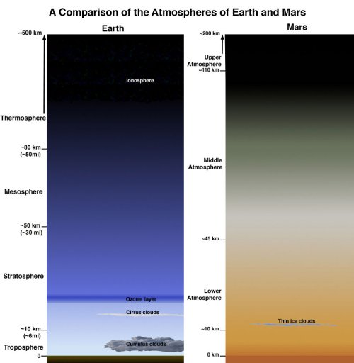
Atmosphere of Mars
Atmosphere is mostly Carbon dioxide (C02)
Very thin cloud cover
1 % the atmospheric pressure of Earth
Low density (3.3 xwater) and small size make the pull of gravity very weak, less than Mercury!
A 100 lb object would weigh 37 lbs on Mars

Slide 25
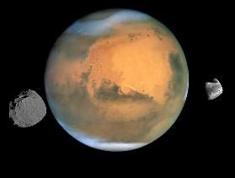
Moons of Mars
2 small crater covered moons
  Phobos
  Deimos

Slide 26

Terrestrial Planets Overview
Also known as Terrestrial Planets (meaning Earth-like)
Made up of rock and metal
Warmer than Outer Planets
Much smaller than Outer Planets
Have relatively
  High density
  Slow rotation
  Thin Atmosphere
  No rings
  Few satellites
  Solid surfaces

Slide 27
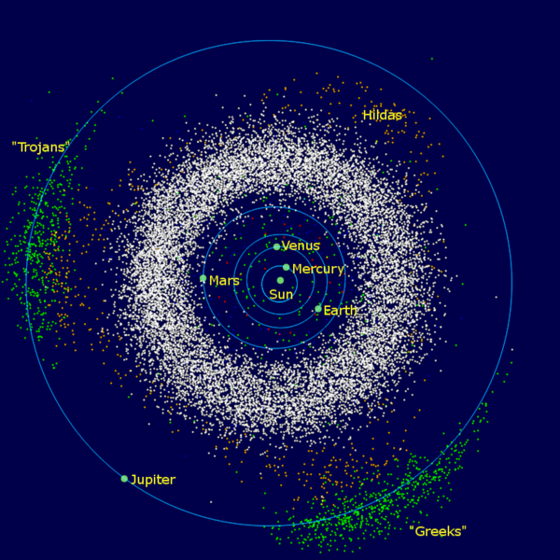
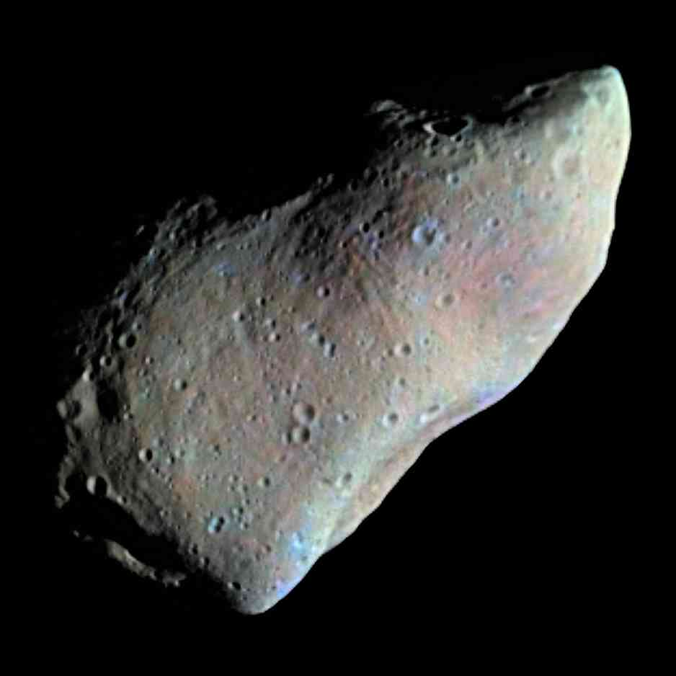
Asteroid Belt
Space between Mars and Jupiter
Filled with many irregularly shaped bodies and would-be planet forming materials called Planetesimals

Slide 28
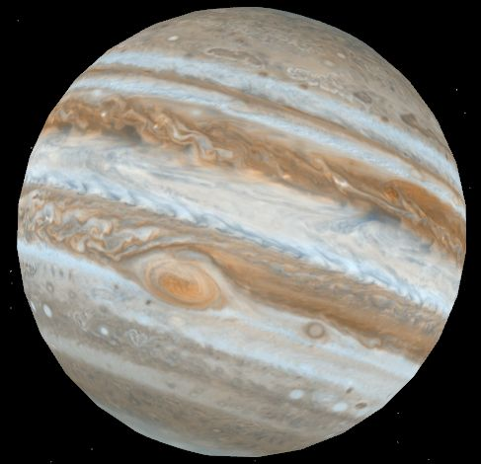
Jupiter
Largest & Most Massive Planet
  1/1000th mass of the sun
  2.5 times the mass of all other planets combined
Core is hotter than the sun, Radiates more energy than it receives from the sun due to gravitational compression
Temperature
  Atmosphere -110ºC
  Core 36000ºC

Slide 29
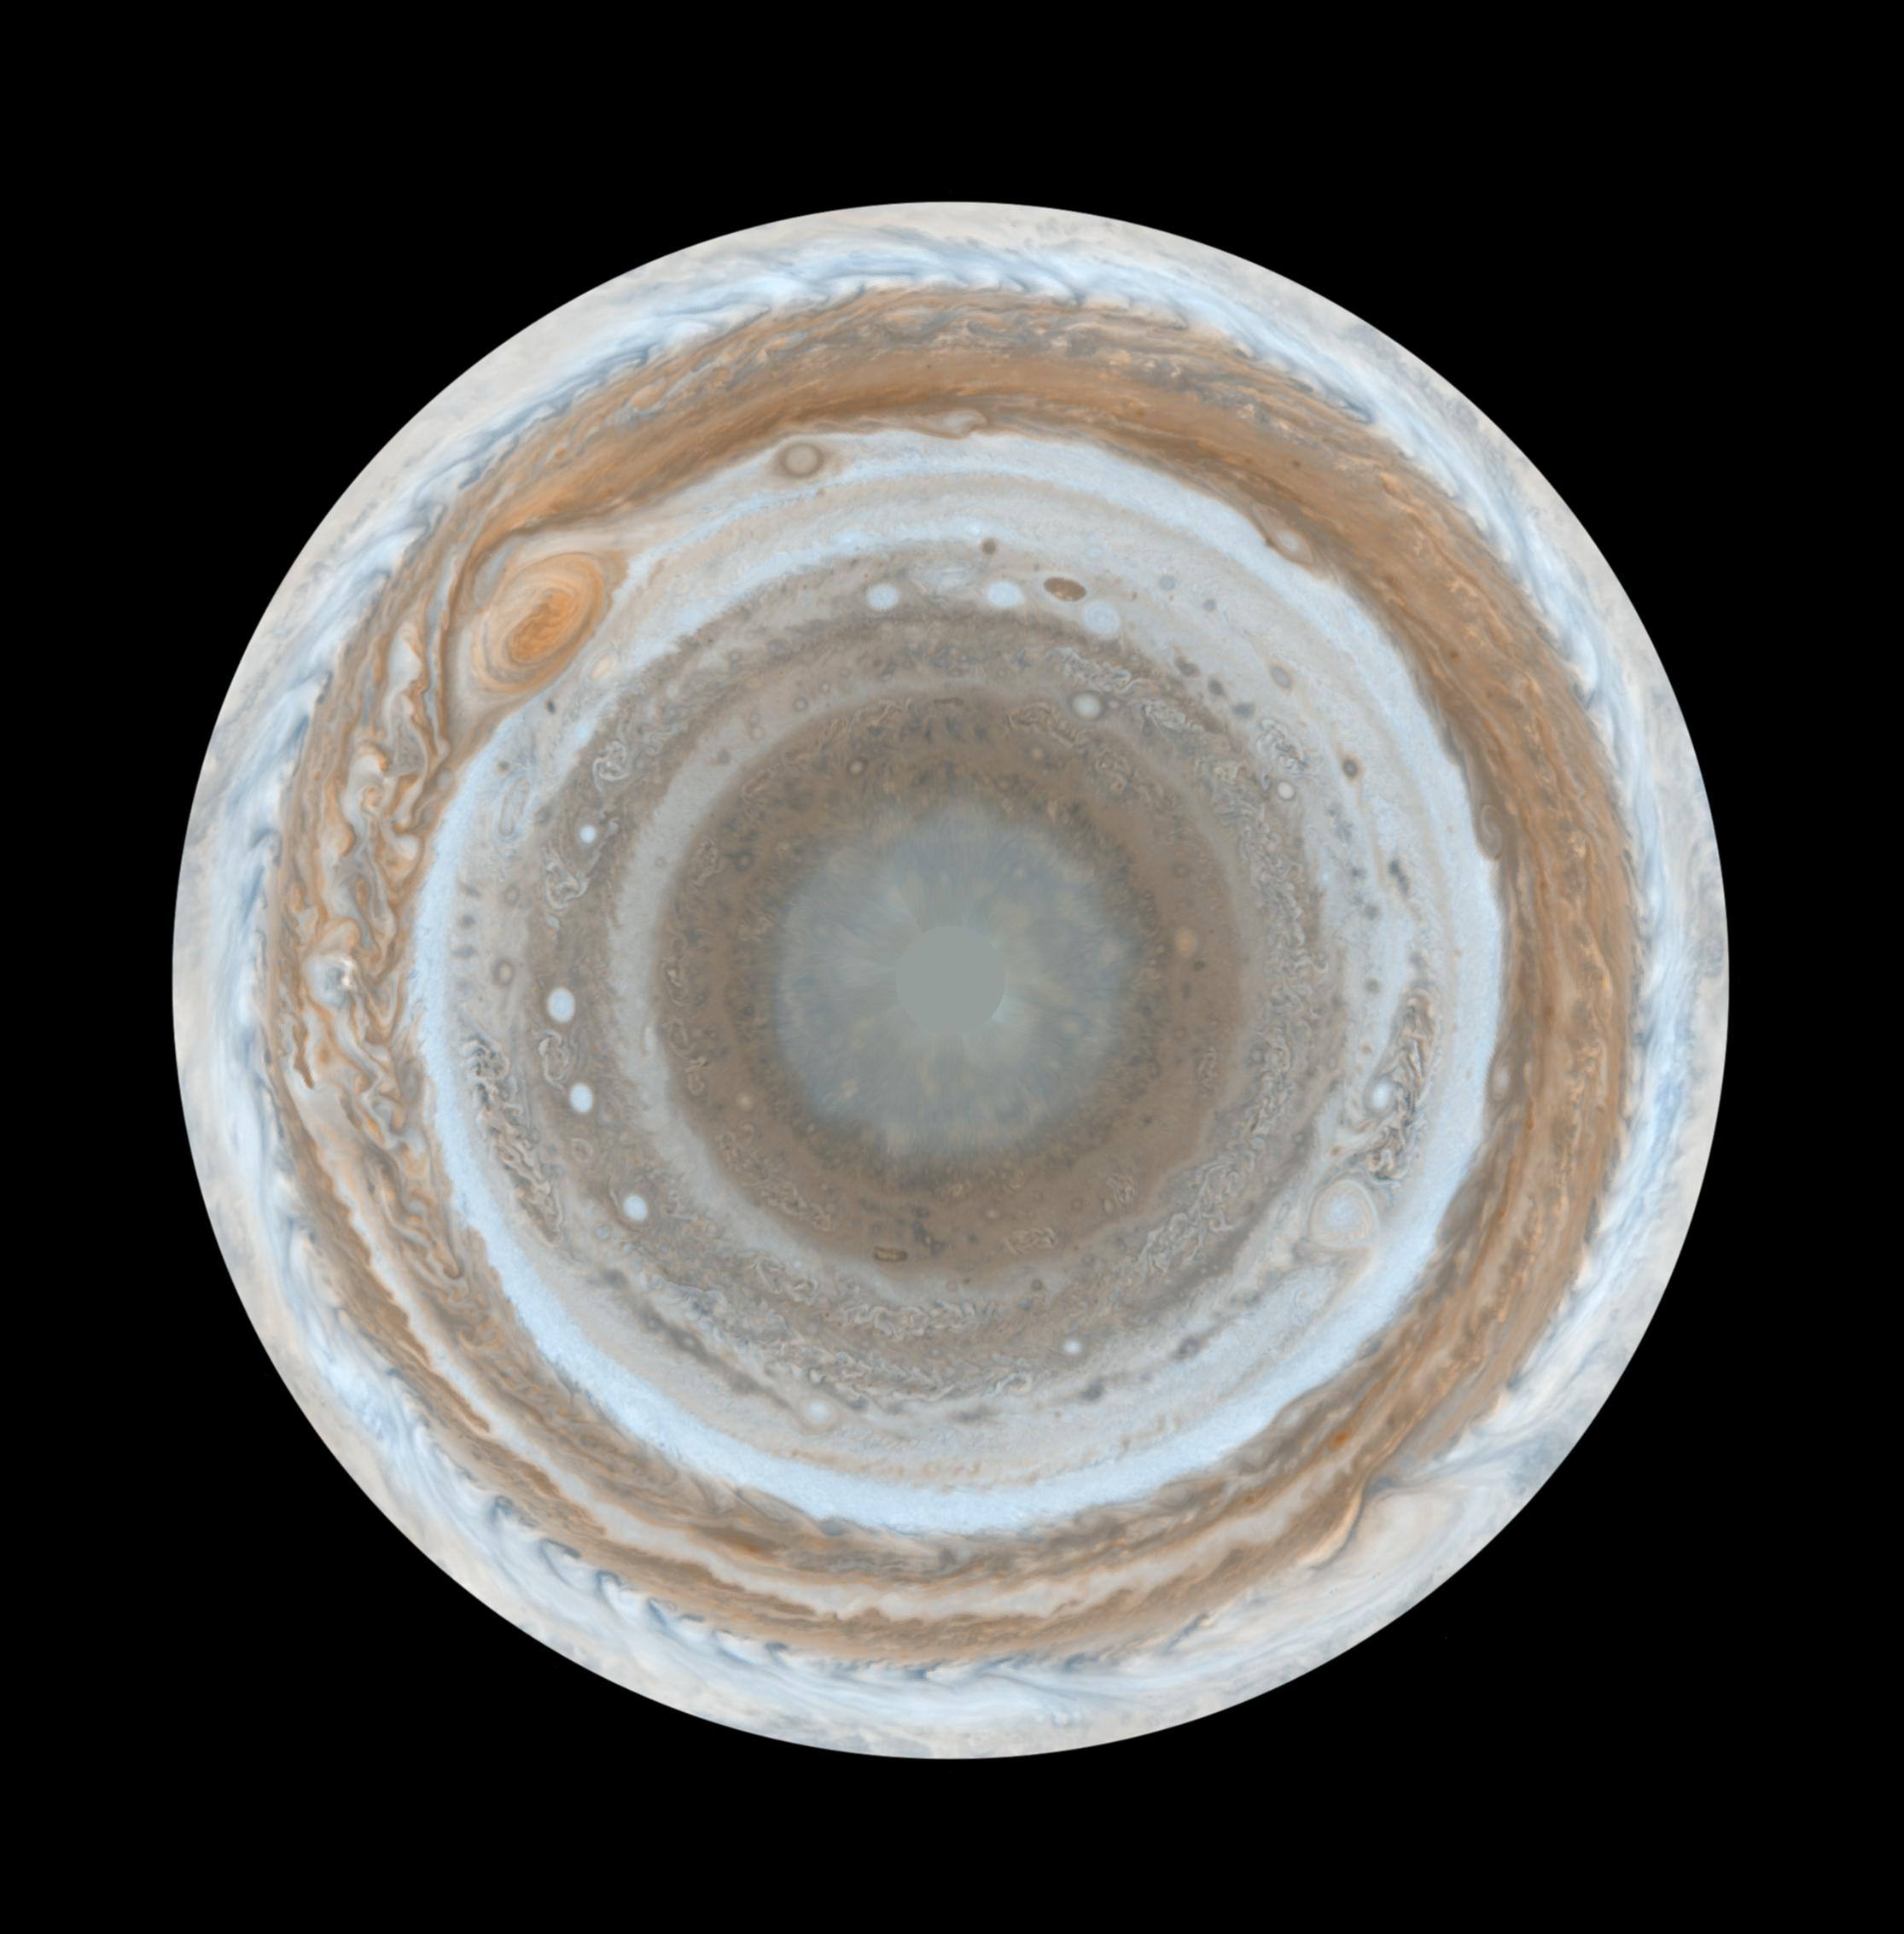
Motions of Jupiter
Length of rotation-10 hours
Length of revolution-11.87 years
Has the Most circular orbit
The fastest rotation of all the planets
If Earth is going 100 mph, Jupiter going 22,000 mph
Fast spinning, creates a bulge at the equator
As a result of non-solid surface, the poles rotate faster than equator
http://upload.wikimedia.org/wikipedia/commons/a/a3/790106-0203_Voyager_58M_to_31M_reduced.gif

Slide 30
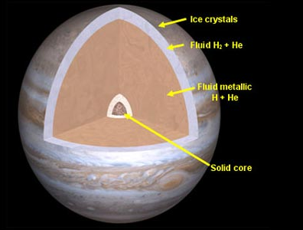
Composition of Jupiter
Thick liquid atmosphere with relatively tiny solid core
Composed primarily of Hydrogen and Helium
Clouds made of Ammonia Ice crystals

Slide 31
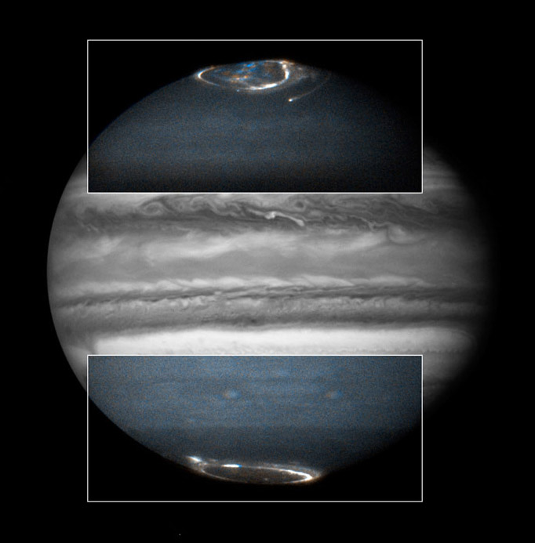
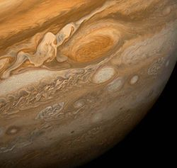
Climate of Jupiter
http://upload.wikimedia.org/wikipedia/commons/7/76/PIA02863_-_Jupiter_surface_motion_animation.gif
Jupiter is a windy and stormy
  Wind speeds more than 400 mph
  Some lightning
Exhibits Aurora light display!
Jupiter’s Red Spot
  Oval shaped counter-clockwise storm moving storm 4 times larger than Earth

Slide 32
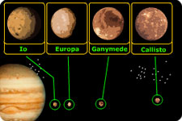
Moons of Jupiter
63 known satellites total- many 7-13 million miles away
Galileo discovered 4 largest in 1610
Very different properties
  Io covered in volcanoes
  Europa icy crust with liquid water underneath
  Ganymede largest moon
  Callisto completely covered in craters

Slide 33
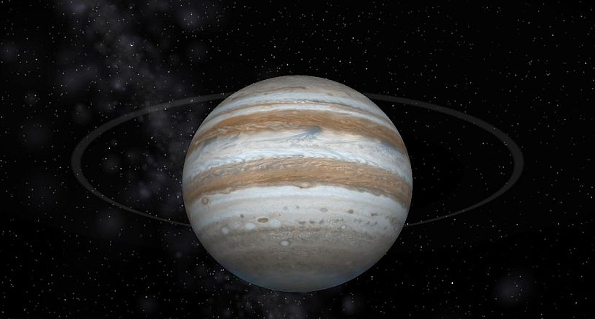
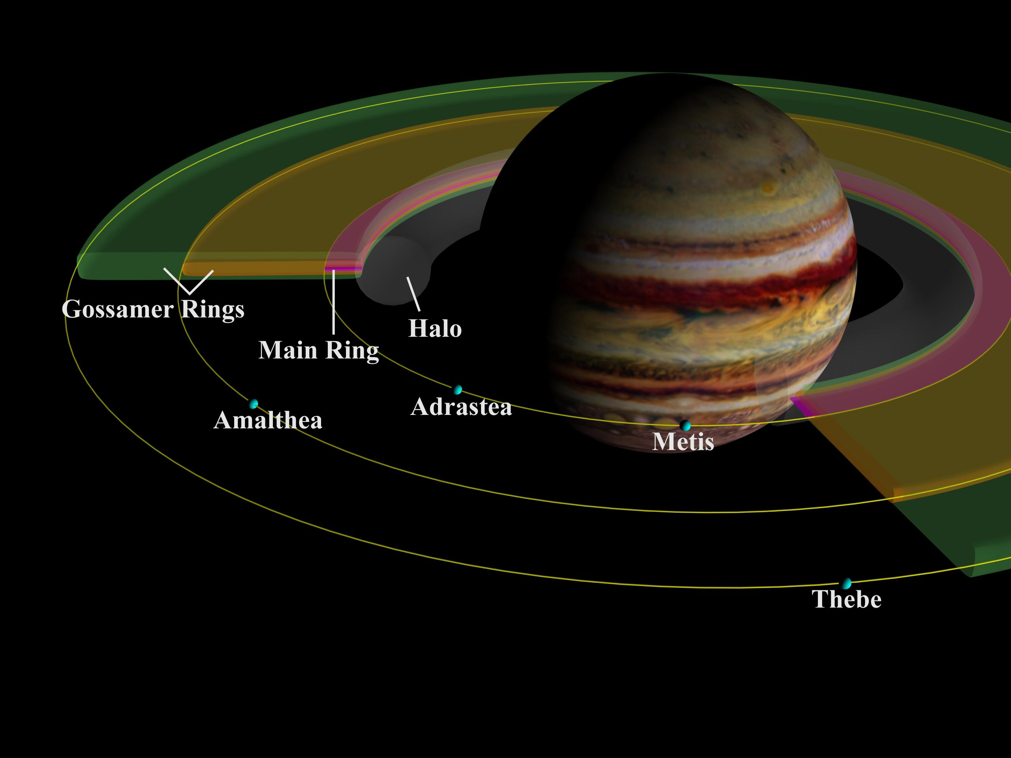
Rings of Jupiter
Rings are made of dust that was likely ejected from the many satellites

Slide 34
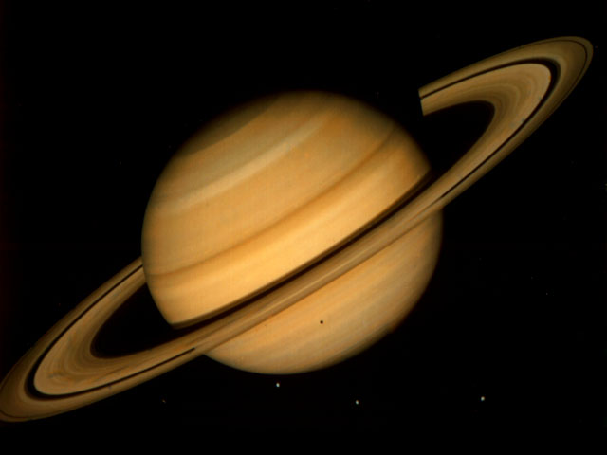

Saturn
Second largest planet, slightly smaller than Jupiter
Twice as far from the Sun as Jupiter
Less dense than water, it would float!

Slide 35
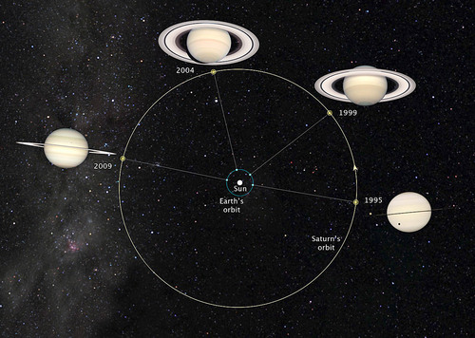
Motions of Saturn
Has a similar axis tilt to earth- 27 degrees
As Saturn moves, and tilts, our view of its rings changes
Length of rotation- 10.75 hours
Length of revolution- 29.5 years

Slide 36
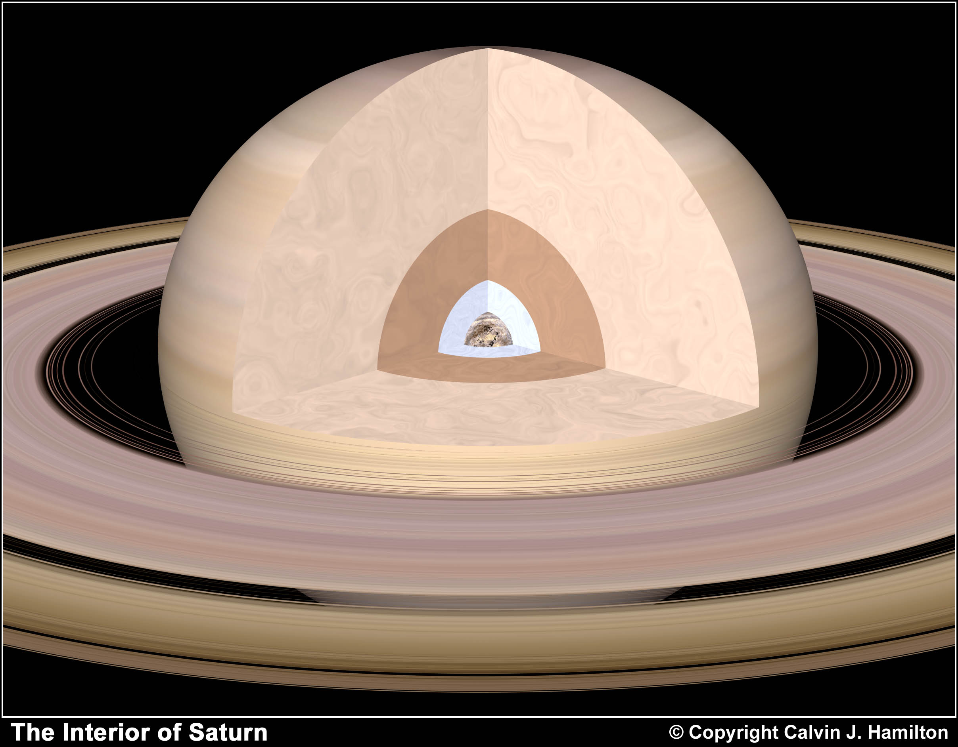
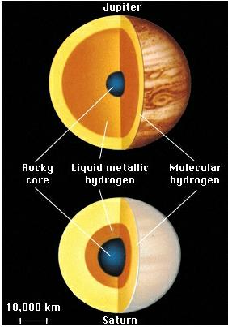
Composition of Saturn
Composed Mainly of Hydrogen , Helium, Methane, and Ammonia
Thick gas/liquid atmosphere with tiny rock core
Clouds of Ammonia ice crystals

Slide 37
Climate of Saturn
Temperature
  Atmosphere -175 degrees C
  Core 11,700 degrees C
Colder than Jupiter
Less dramatic clouds and storms than Jupiter
Extremely high wind speeds, up to 1,000 mph
The planet gives off about 2.5 times more heat energy than it receives from the Sun.
  Many astronomers believe that much of Saturn's internal heat comes from energy generated by the slow sinking of helium through the liquid hydrogen in the planet's interior.

Slide 38
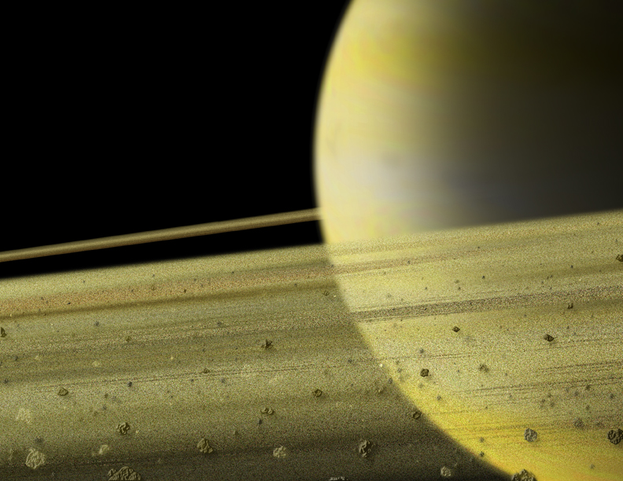
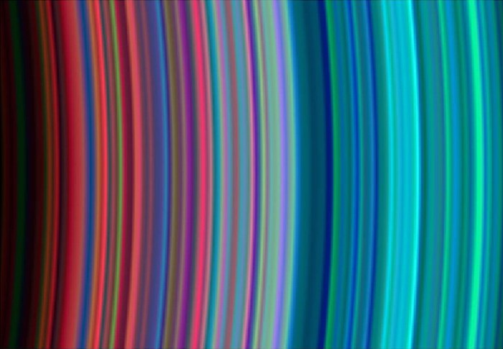
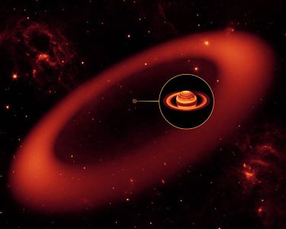
Rings of Saturn
Galileo first noticed them in 1610, but could not explain them at the time
Rings composed of chunks of rock, dust, and ice
In 2009, Astronomers have discovered a dust halo around Saturn that extends for millions of miles around it
Infrared Images

Slide 39

Moons of
Saturn
52 recognized moons, more reported
Difficult to discern from the many ice chunks that revolve as part of Saturn’s ring system

Slide 40

Titan
Saturn’s largest moon
Larger than Earth’s Moon
Titan is the only moon in
the Solar System to have an atmosphere
Titan is the only place besides Earth of have copious amounts of liquid, has methane/ethane lakes
Exhibits fog indicating liquid cycling (like earth’s water cycle)
Has organic compounds, atmosphere, and a liquid environment that has life ingredients, but Titan may be too cold

Slide 41

Uranus
First new planet discovered since ancient times by William Hershel 1781
4 times the diameter of Earth
Twice as far from the sun as Saturn,
Coldest planet in the solar system
Does not emit much heat, like other “Giants”
Temperature Range
  Atmosphere -224 degrees C
  Core 4700 degrees C

Slide 42

Motions of Uranus
Length of rotation- 17 hours
Length of revolution- 84 years
Uranus is tilted 98 degrees from vertical
So from our perspective, it rotates top to bottom
Astronomers predict this strange tilt may be the result of the gravitational pull from a large moon that has since been ejected from Uranus’ orbit
Notes:
http://www.solstation.com/stars/uranus.htm

Slide 43

Composition of Uranus
Composed of Hydrogen, Helium, Methane and more ices than Jupiter or Saturn
Blue appearance due to traces of Methane
Least massive of the outer planets
Rocky core
Icy mantle
Hydrogen Helium Envelope

Slide 44

Moons and Rings of Uranus
27 satellites
Very faint rings composed of black dust particles and boulder sized rocks
arcsecond - A second of arc or arcsecond is a unit of angular measurement which comprises one-sixtieth of an arcminute, or 1/3600 of a degree of arc or 1/1296000 (approximately 7.7×10-7) of a circle. It is the angular diameter of an object of 1 unit diameter at a distance of 360×60×60/(2pi)
Infrared Image

Slide 45
Neptune
Discovered 1846 due to mathematical prediction . Astronomers suspected another planet was affecting the orbit of Uranus
Smaller but denser than Uranus 2005.
In 2005, astronomers proposed that Uranus and Neptune may have formed much closer to the Sun before migrating outwards and swapping places in the process (Maggie McKee, New Scientist, May 22, 2005)
Temperature Range
  Atmosphere -200 degrees C
  Core 7000 degrees C

Slide 46
Motions of Neptune
Length of rotation- 16.5 hours
Length of revolution- 164 years
The average temperature of -200 Celsius
South pole is 10 degrees warmer than the rest of planet. This hot spot occurs because Neptune’s south pole is currently exposed to the Sun.
As Neptune continues its journey around the Sun, the position of the poles will reverse. Then the northern pole will become the warmer one, and the south pole will cool down.

Slide 47


Compostion of Neptune
Mostly Ices and Rock
15% Hydrogen and Helium, trace amounts of Methane
Presences of Cirrus Clouds

Slide 48

Atmosphere of Neptune
Had a great storm in the southern hemisphere, The Great Dark Spot, much like Jupiter
Fastest winds in the solar system 1,200 mph

Slide 49

Internal Heat of Neptune
Like Jupiter and Saturn, Neptune appears to have an internal heat source and so it radiates more than twice as much energy as it receives from the Sun. Planetary scientists believe that deep inside Neptune, pressure builds (and heat) until much of its formerly gaseous hydrogen turns into liquid metallic hydrogen, again like Jupiter and Saturn. Under such conditions, the methane found in Neptune's atmosphere also decomposes, as the bonds holding methane's four hydrogen atoms dissolve and the carbon atoms may bind to one another in the extreme pressure to form diamonds (according to a new hypothesis by a team at the University of California at Berkeley and experiments conducted by Robin Benedetti). Hence, a rain of diamonds may be falling toward Neptune's core, which release heat through friction with its heavy atmosphere (Curtis Rist, Discover, September 2000).
Notes:
http://www.solstation.com/stars/neptune.htm

Slide 50
Moons of Neptune
At least 13 satellites
Some of Neptune’s moons did not form at the time of Neptune’s formation, but were captured later by gravity
One piece of evidence for this is that Neptune’s largest moon, Triton, revolves in the opposite direction of Neptune’s rotation

Slide 51

Jovian Planets Overview
Also known as Jovian Planets (meaning Jupiter-like)
Made up of Hydrogen, Helium, and ices
Colder than Inner Planets
Much larger than Inner Planets, that’s why they are called “Gas Giants”
Have relatively
  Low density
  Rapid rotation
  Deep atmospheres
  Have rings
  Many satellites

Slide 52


Pluto- Dwarf Planet
Less than 2 x smaller than The Moon
Merely the largest of thousands of objects that revolve around the sun outside of Neptune
If astronomers had discovered the objects first, they may never have called a Pluto a planet
The new definition offered today would set up a three-tiered classification scheme with eight “planets”; a group of “dwarf-planets” that would include Pluto, Ceres, Xena and many other icy balls in the outer solar system; and thousands of “smaller solar system bodies,” like comets and asteroids.
Pluto is now identified as part of the Kuiper Belt
Notes:
Unlike winds on the inner rocky planets like Earth, which are powered primarily by sunlight, winds on the gas giants are also fed by heat escaping from their deep cores, although the strength of this interior heat is a mere fraction of the sunlight falling on Earth. Like Jupiter, Saturn appears to have a liquid layer of metallic hydrogen lower in its interior surrounding a hot rocky core that may be as hot as 12,000 °C (or F). The planet also radiates more energy into space than it receives from the Sun, of which much is probably generated by gravitational compression like Jupiter.
Dwarf Planet - This is a celestial body that: (a) is in orbit around the Sun; and (b) has sufficient mass for its self-gravity to overcome rigid body forces so that it assumes a nearly round shape (due to a hydrostatic equilibrium); but (c) has not cleared the neighborhood around its orbit; and (d) is not a satellite of another planet. As defined, the Solar System has probably has at least one dwarf planet in the Main Asteroid Belt (Ceres), Edgeworth-Kuiper Belt (Pluto and Eris); and Oort Cloud (possibly Sedna). In addition, the "dwarf planet" Pluto is recognized as a prototype of a new class of trans-Neptunian objects.

Slide 53


Kuiper Belt
Source of short period comets
Come from a disc shaped region outside Neptune
Where potential planet forming debris collected

Slide 54

Oort Cloud
Source of long period comets
Icy rocky remnants left over from the creation of the solar system
On the outskirts of our solar system, where suns gravity ends
Occasionally icy bodies are knocked out of balance by giant molecular clouds or stars passing nearby, or tidal interactions with the milky way galaxy’s disc.

Slide 55

Our Solar System is located in one of the spiral arms of the Milky Way Galaxy (view from above)
There are many other suns orbiting in the Milky Way
We now know that many of those suns have planets of their own

Slide 56

Milky Way (Side View)

Slide 57

The Milky Way is only one of many many Galaxies orbiting the center of the Universe

